Slide 2
Cordova: Less of a (phone)gap than ever
Damian Karzon
M334

Slide 3
What and Why of Cordova Tools and Frameworks Platform integration

Slide 4
Apache Cordova is a platform
for building native mobile
applications using HTML, CSS
and JavaScript

Slide 5
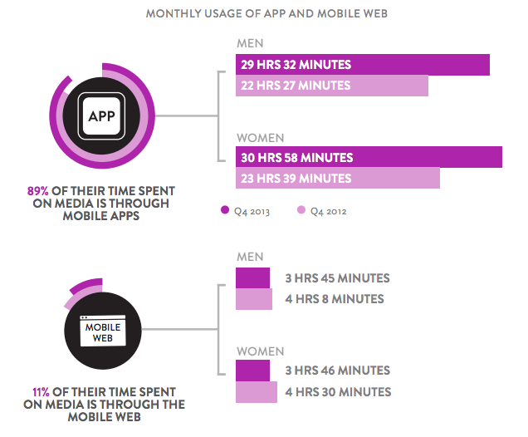
More time in apps than mobile web
http://www.smartinsights.com/marketplace-analysis/customer-analysis/consumer-media-device-use/

Slide 6

But javascript?
Javascript is everywhere*
FREE tools
Huge dev community
Notes:
http://giphy.com/gifs/javascript-framework-greensock-VHypjqI6afqpy

Slide 7
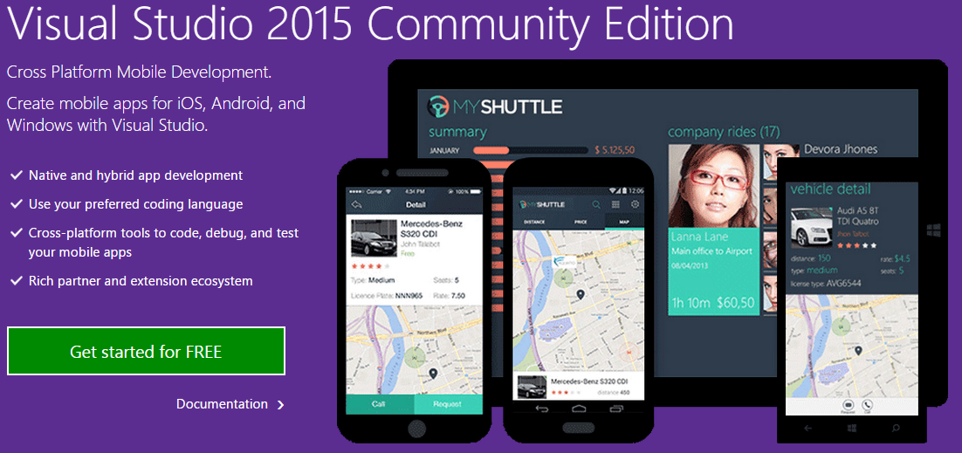

Slide 8
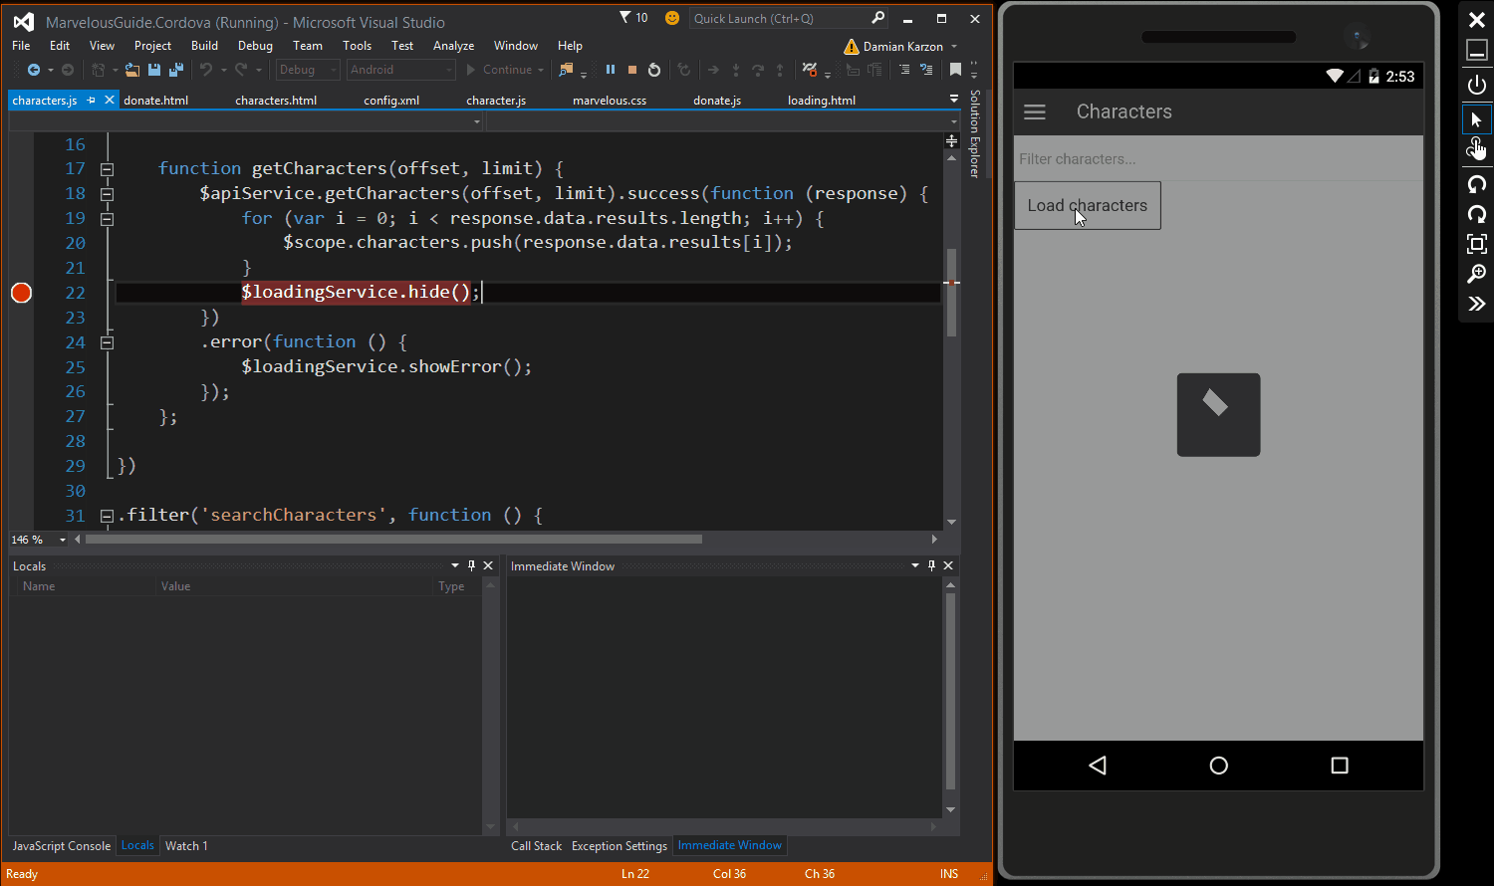

Slide 9
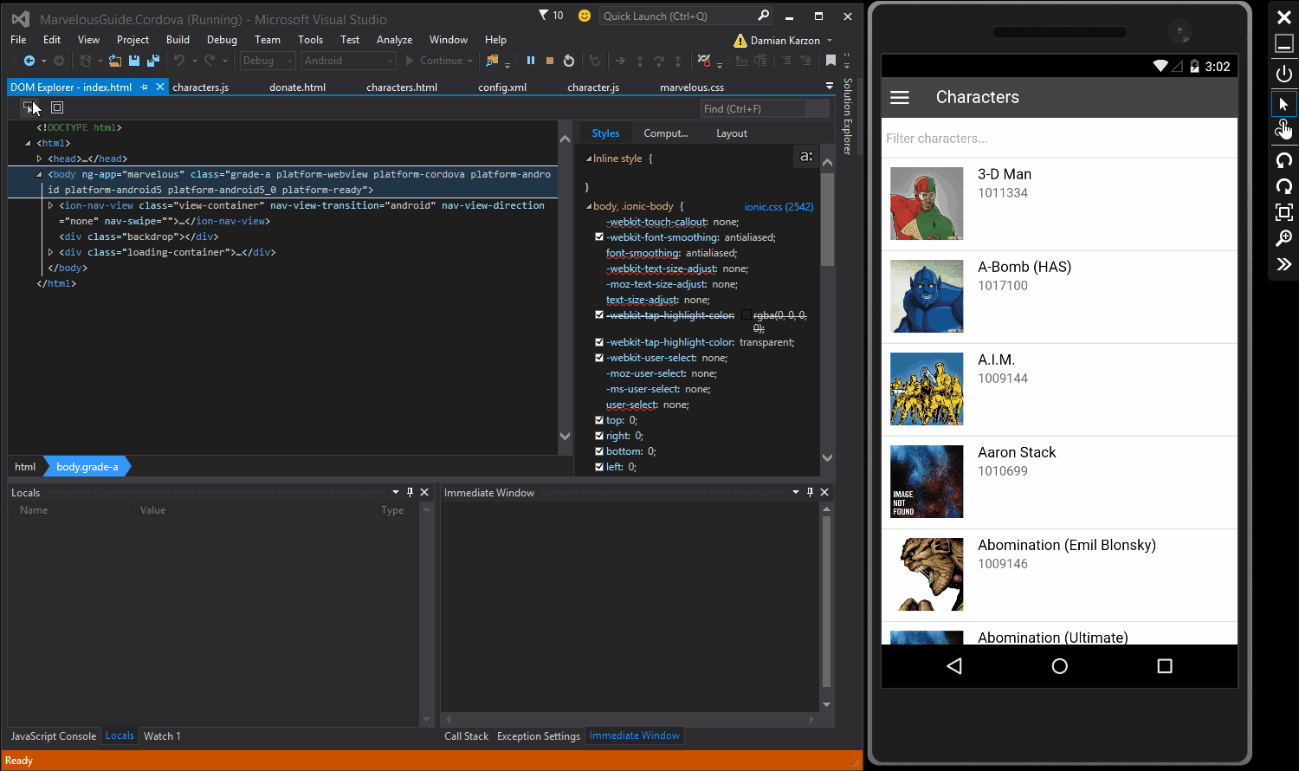

Slide 10

Vorlon.js
http://vorlonjs.com/
Remotely debug and
test your JavaScript

Slide 11
Crosswalk project
https://crosswalk-project.org/
Include a better webview with your app

Slide 12
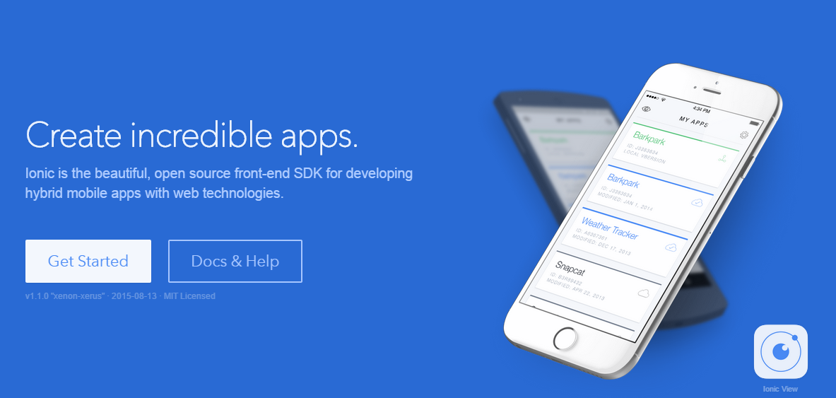
Ionic Framework http://ionicframework.com/

Slide 13
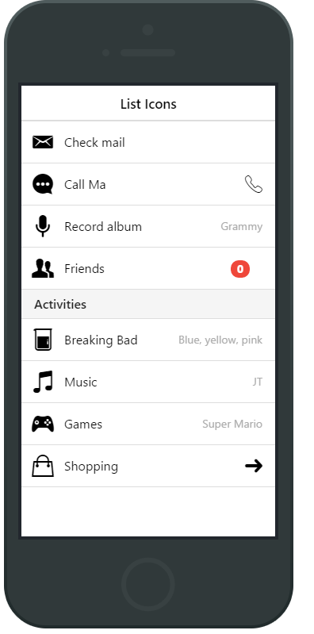
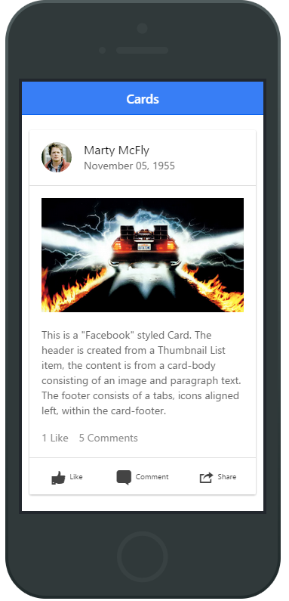
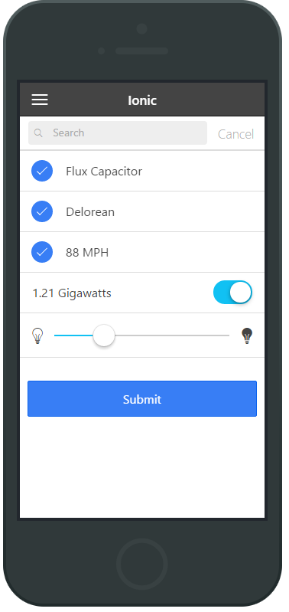
Notes:
http://pastebin.com/duVX5783

Slide 14
Sweet platform bro
Plugins and platform specifics

Slide 15
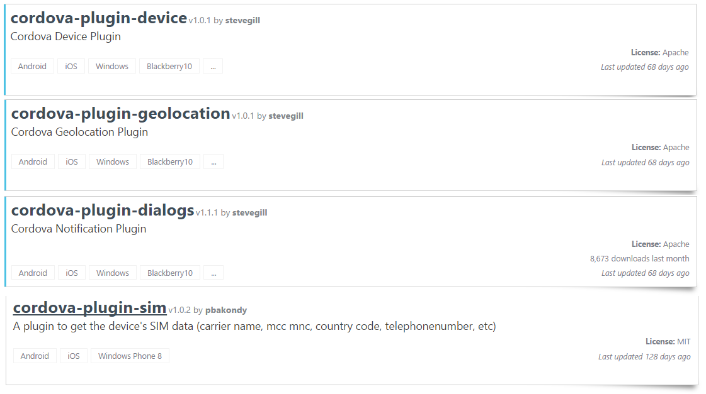
http://plugins.cordova.io/

Slide 16
Show me some code

Slide 17


Damian Karzon
App/Game/Web Developer
Marker Metro
Questions
/dkarzon
/dkarzon

Slide 18

Related Ignite NZ Sessions
1
Universal Apps: A Developers Guide
Ballroom 1 Wed 9:00am
4
Web+Mobile+IOT: Joining The Dots
NZ4 Thu 4:30pm
2
5
Devices Devices Devices!
SKYCITY Theatre Fri 1:55pm
Internet Explorer and Edge in the Enterprise
NZ1 Thu 9:00am
Find me later at…
Hub Happy Hour Wed 5:30-6:30pm
Hub Happy Hour Thu 5:30-6:30pm
Closing drinks Fri 3:00-4:30pm
Twitter: @dkarzon
3
Developing Cross Platform Mobile Apps with XAML and MVVM
NZ4 Thu 1:55pm

Slide 19





Resources
Microsoft Virtual Academy
TechNet & MSDN Flash
Free Online Learning
http://aka.ms/mva
Subscribe to our fortnightly newsletter
http://aka.ms/technetnz http://aka.ms/msdnnz
Sessions on Demand
http://aka.ms/ch9nz

Slide 20


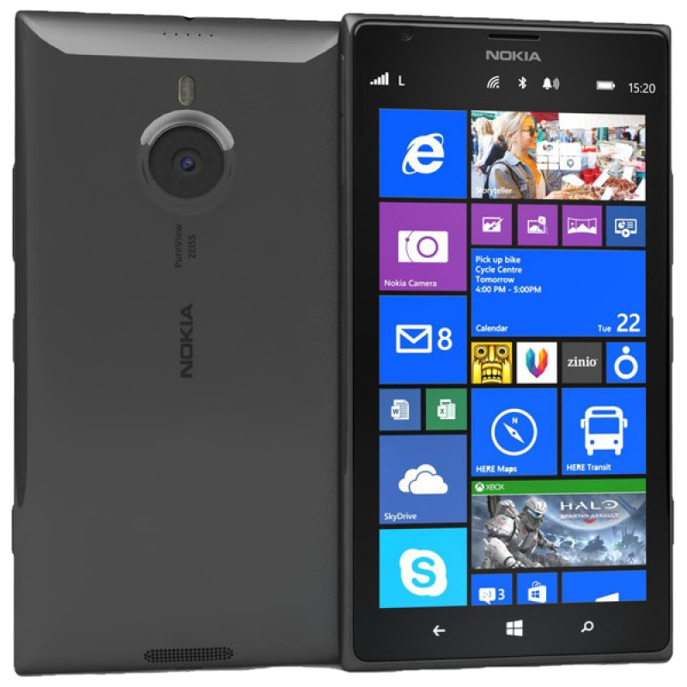


Complete your session evaluation now and be in to win!

Slide 21


